Slide 1
Presentation on OpenRefine
Name: Jeba Tahsin Hossain
ID: 20241066
Course: CSE424
Date: 24/08/2021

Slide 2
Introduction
OpenRefine, formerly GoogleRefine, is a sophisticated open source program that visualizes and manipulates massive amounts of data at the same time
OpenRefine resembles a spreadsheet but functions more like a database, providing for more exploration possibilities than Microsoft Excel
OpenRefine maintains its users' information private on their own computer, unless they agree to share or contribute
It runs by operating a mini server on the user's PC and interacting with it through their browser
More than 15 languages are supported by OpenRefine

Slide 3
Functionality
On a broad scale, OpenRefine may be used to analyse, filter, and connect data. Among the functions are:
Data normalization
Column reorganization
Faceting and clustering
Tracking operations
Exporting data

Slide 4
Algorithms in OpenRefine
The "Clustering" mechanism is one of OpenRefine's greatest advanced functionality
The Clustering technique can assist to identify irregularities in the data by using a variety of key collision and nearest neighbour algorithms
Clustering functions by using a technique known as "fuzzy matching" based on a specified column, by using a chosen algorithm, to see whether any potential cell values "resemble" enough to be probable matches
There are two types of algorithms that OpenRefine supports:
Key collision
Nearest neighbor

Slide 5
Mechanism of Clustering
The clustering window can be opened in 2 ways:
By running a "Text facet" from a chosen column and then choosing the “Cluster” button at the top of the facet window, or
By selecting the arrow button on the column header for the column to cluster, and then picking the “Edit cells” option and then “Cluster and edit.”
There are various options in the Clustering window:
Choosing the kind of algorithm to perform from the top of the window.
A set of recommended clusters, existing values, and suggested additional values can be found in the window's center
There are various sliding scales on the right which can be applied to compress the clustering criteria: number of options in the cluster, total rows in the cluster, average length of values in a cluster, or variance in length of values in a cluster

Slide 6
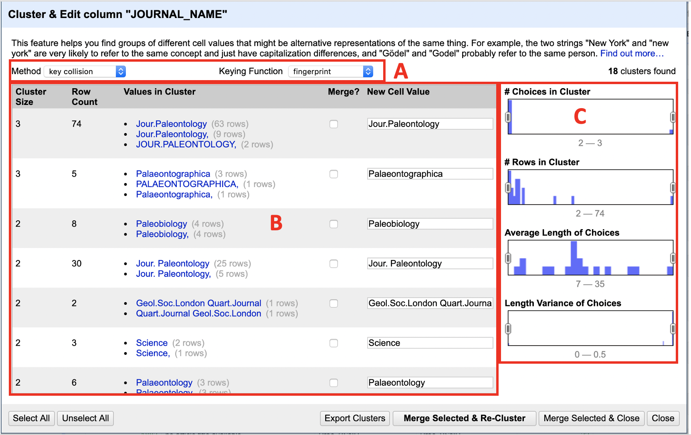
Mechanism of Clustering

Slide 7
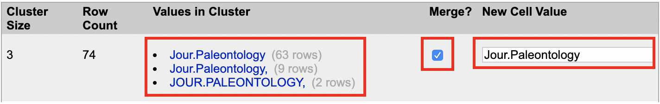
Mechanism of Clustering
Choosing the algorithm that best matches the requirements, and then thinking about the clusters that have been proposed
By selecting the “Merge?” box for clusters to keep, making sure the text field in the “New Cell Value” column matches the value to the wanted modified clustered data
Repeating these steps for every cluster that has been recommended

Slide 8
Mechanism of Clustering
Selecting between “Merge Selected & Re-Cluster” or “Merge Selected & Close” once the user is ready
“Merge Selected & Re-Cluster” changes the selected values before re-running the clustering algorithm on the same column automatically
“Merge Chosen & Close” makes changes to the selected values before closing the Clustering window

Slide 9
Examples
There are a variety of clustering methods available in the scikit-learn library
The following is a list of 10 of the most common algorithms:
Agglomerative Clustering
Affinity Propagation
OPTICS
BIRCH
DBSCAN
K-Means
Mini-Batch K-Means
Mean Shift
Mixture of Gaussians
Spectral Clustering

Slide 10
References
O. Stphens, “Clustering In Depth”, OpenRefine, GitHub, 2021. URL: https://github.com/OpenRefine/OpenRefine/wiki/Clustering-In-Depth
“OpenRefine”, Wikipedia, 2021, URL: https://en.wikipedia.org/wiki/OpenRefine
B. Michael, “OpenRefine”, Illinois Library, University of Illinois, 2021. URL: https://guides.library.illinois.edu/openrefine/about
“OpenRefine”, 2021. URL: https://openrefine.org/
J. Brownlee, “10 Clustering Algorithms With Python”, Machine Learning Mastery, 2020. URL: https://machinelearningmastery.com/clustering-algorithms-with-python/

Slide 11
Thank You!

